Slide 1
CSRF and Tools
Dabin Ding

Slide 2
Cross-Site Request Forgery (CSRF)
“Cross-Site Request Forgery (CSRF) is an attack that forces an end user to execute unwanted actions on a web application in which they're currently authenticated. ”

Slide 3
“With a little help of social engineering (such as sending a link via email or chat), an attacker may trick the users of a web application into executing actions of the attacker's choosing. If the victim is a normal user, a successful CSRF attack can force the user to perform state changing requests like transferring funds, changing their email address, and so forth. If the victim is an administrative account, CSRF can compromise the entire web application.”

Slide 4
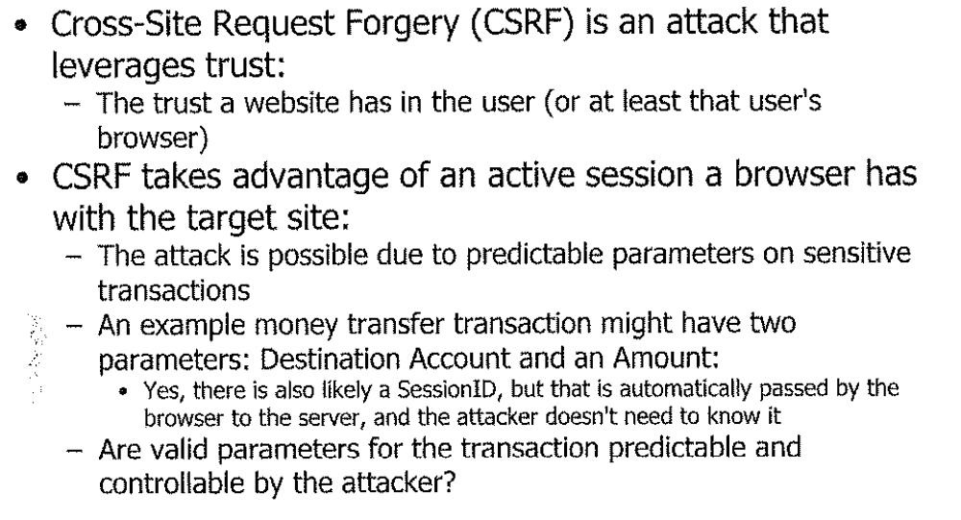
Cross-Site Request Forgery

Slide 5

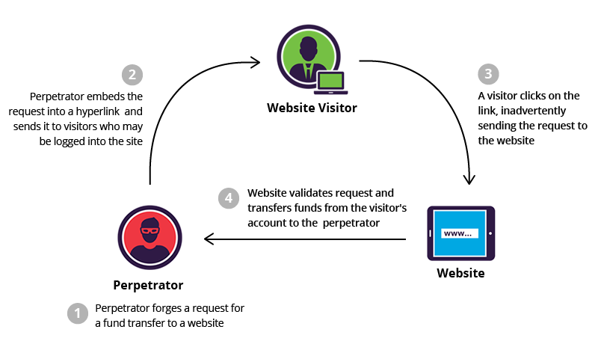
Cross-Site Request Forgery

Slide 6
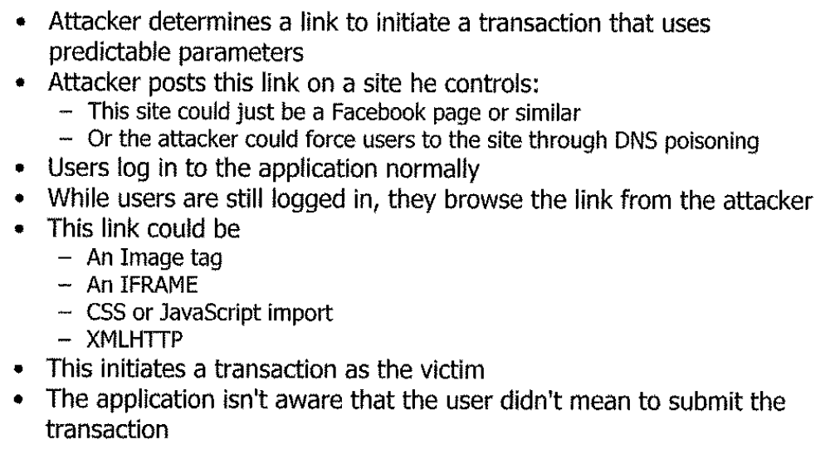
Cross-Site Request Forgery

Slide 7
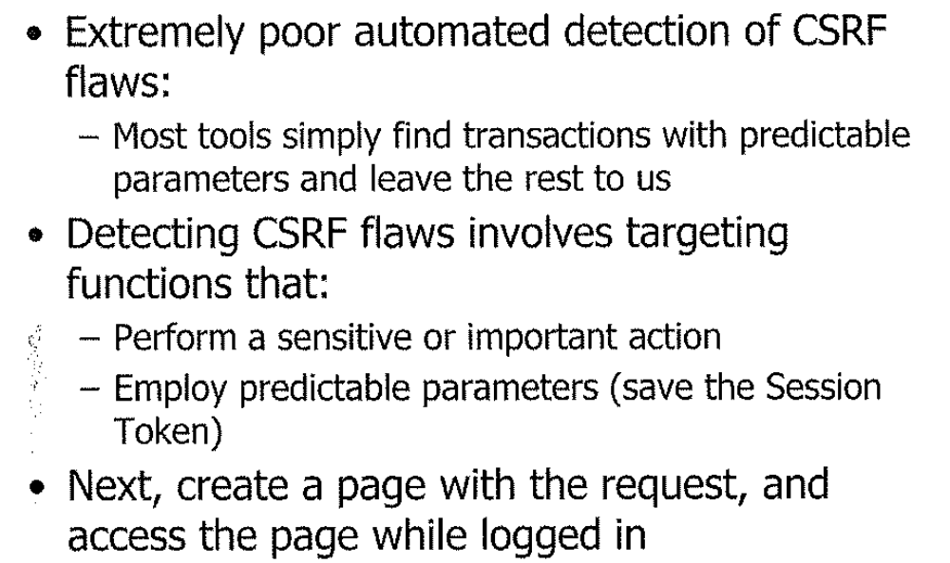
Detecting CSRF

Slide 8
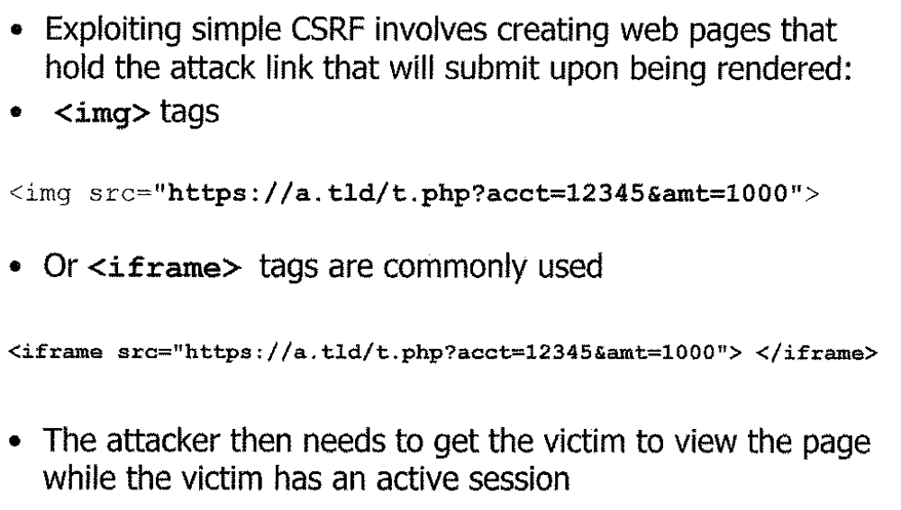
Attacking CSRF

Slide 9
Cross-Site Request Forgery
ZAP includes the capability to generate a proof of concept attack
ZAP will build a simple web page that includes a form that submits any items in the page from which you are starting
The form can serve as an initial attack for the CSRF flaw before weaponizing it with an XHR

Slide 10
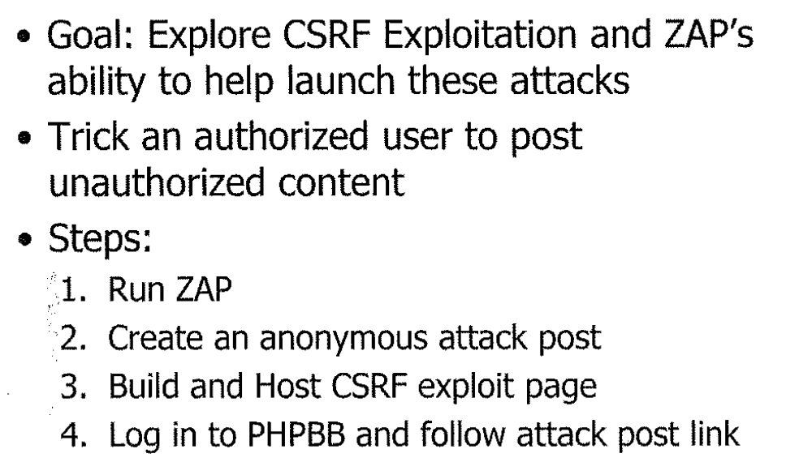
CSRF: Exploitation Exercise
P15

Slide 11
CSRF Prevention
#1 Rule out Cross-site Scripting (XSS) vulnerabilities; otherwise all of the following prevention will fail.
#2 Check Origins in HTTP Header
  Check target origin if behind a proxy
#3 Secure One-time Token
#4 Require user interaction
  A second step confirmation

Slide 12
CSRF Prevention
#1 Rule out Cross-site Scripting (XSS) vulnerabilities; otherwise all of the following prevention will fail.
  any cross-site scripting vulnerability can be used to defeat token, Double-Submit cookie, referer and origin based CSRF defenses.
  MySpace (Samy) worm defeated MySpace's anti-CSRF defenses in 2005
  Can not defeat Captcha, re-authentidation, or one-time passwords

Slide 13
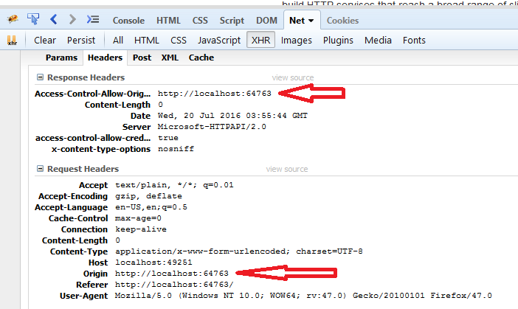
CSRF Prevention
#2 Check Origins in HTTP Header
  If the Origin header is present, then it should be checked to make sure it matches the target origin.

Slide 14
CSRF Prevention
#3 Secure One-time Token
Any state changing operation requires a secure random token (e.g., CSRF token) to prevent CSRF attacks
Characteristics of a CSRF Token
  Unique per user session
  Large random value
  Generated by a cryptographically secure random number generator
The CSRF token is added as a hidden field for forms or within the URL if the state changing operation occurs via a GET
The server rejects the requested action if the CSRF token fails validation

Slide 15
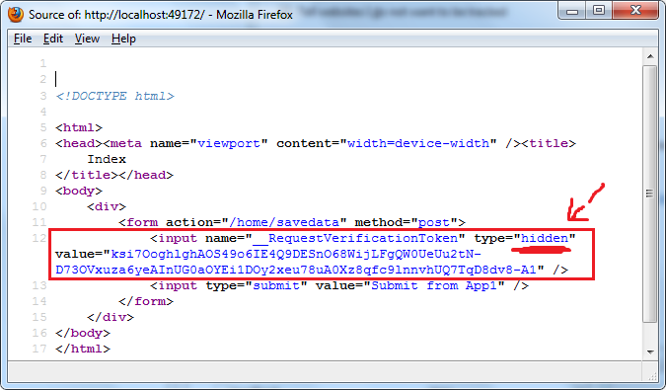
CSRF Prevention
#3 Secure One-time Token
For Java: OWASP CSRF Guard
For PHP and Apache: CSRFProtector Project

Slide 16
CSRF Prevention
Protecting REST Services
Still a research issue
Use of Custom Request Headers
To use custom headers as a CSRF defense, a site must issue all state-modifying requests using XMLHttpRequest, attach the custom header (e.g., X-Requested-By), and reject all state-modifying requests that are not accompanied by the header

Slide 17
CSRF Prevention
#4 Require user interaction
The following are some examples of challenge-response options:
  Re-Authentication (password or stronger)
  One-time Token
  CAPTCHA
User interaction with transaction ID:
  In Step 1: the user provides the email address and the amount of money they want to send.
  In Step 2: the user confirms the proposed transaction.

Slide 18
Some exercises: identify the vulnerabilities from the following figures

Slide 20
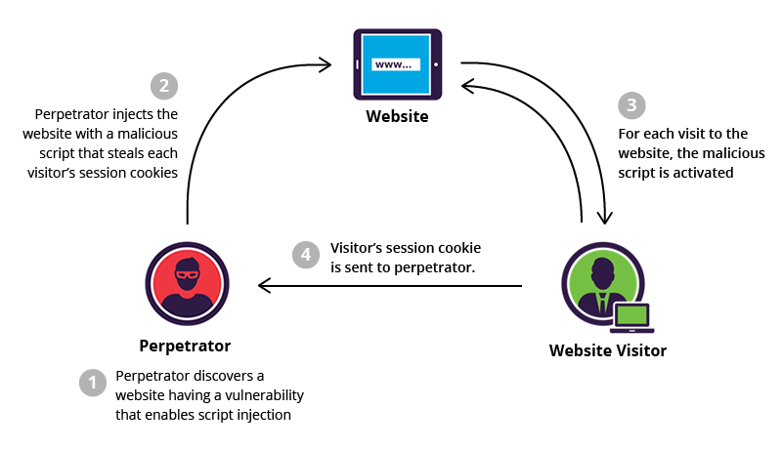

Slide 21
XSS vs CSRF
Look at the following example and identify what kind of attack it is?
<a href="http://netbank.com/transfer.do?acct=AttackerA&amount;=$100">Read more!</a>

Slide 22
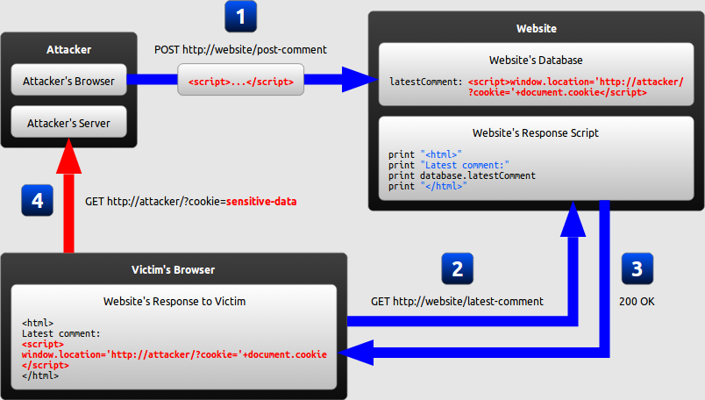

Slide 23
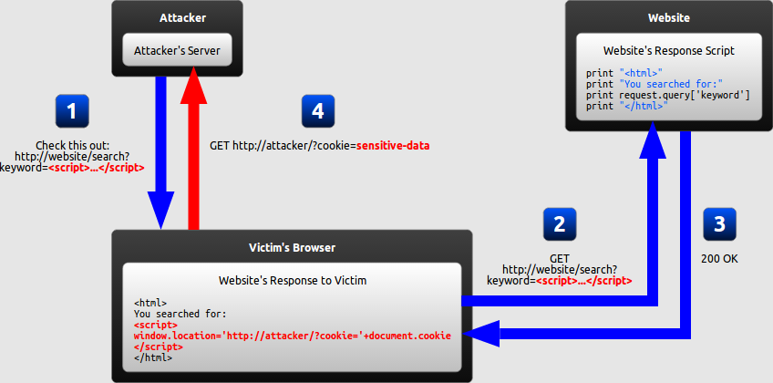

Slide 24
Summary
XSS targets on the client side while CSRF targets the serer side.

Slide 25
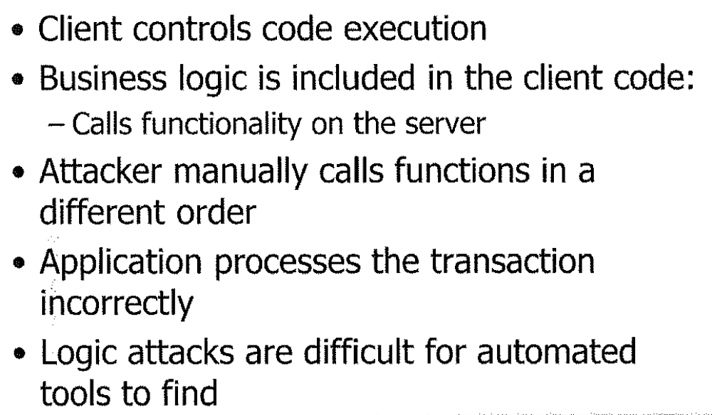
Logic Attacks

Slide 26
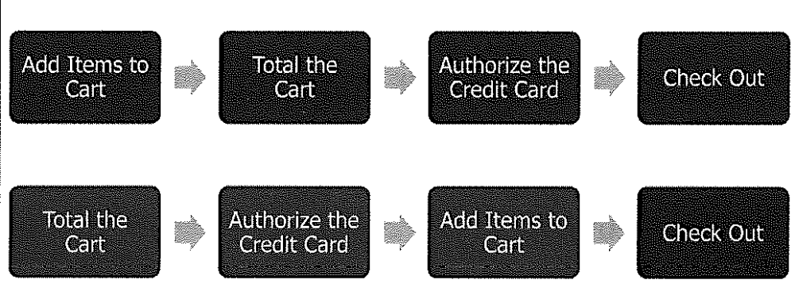
Logic Attack Examples

Slide 27
Detecting Logic Flaws
Discovering is a manual process, most tools can’t examine logic
Hard to find and Harder to fix

Slide 28
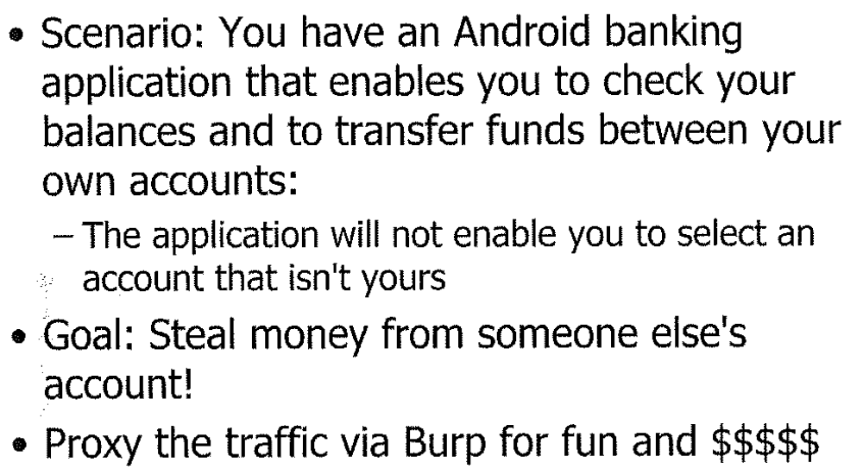
Mobile MITM Exercise

Slide 29
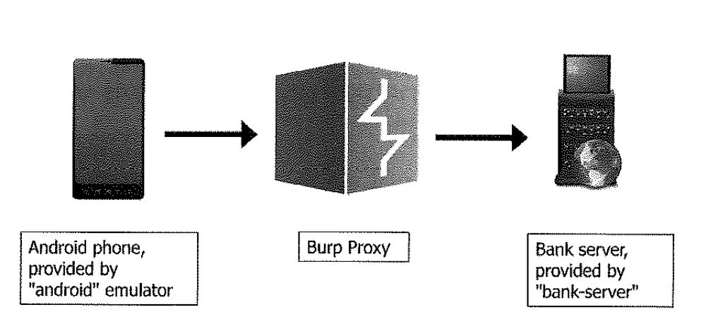

Slide 30
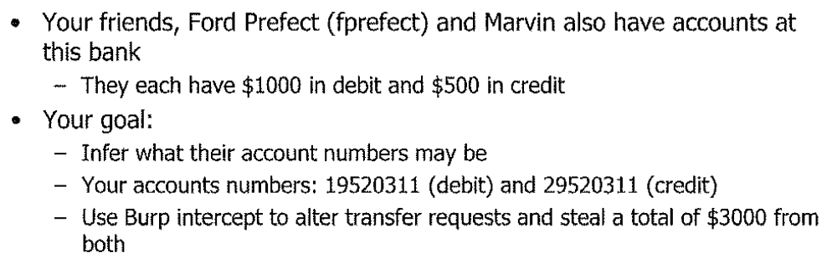
Your Challenge
There are two flaws in the system. One you can steal money no more than bank balance; another one you can steal unlimited amount of money

Slide 31
Wrap up
Flaws discovered and how to fix?
CSRF Prevention Cheat Sheet:
https://www.owasp.org/index.php/Cross-Site_Request_Forgery_(CSRF)_Prevention_Cheat_Sheet

Slide 32
Tools
Python for Pen Testers
WPScan
W3af
Metasploit
When tools fails
Reporting and Presentation

Slide 33
Python
Python can be used to create both web applications and client programs
Comes pre-installed on Mac and Linux, easy to install on Windows
Python standard library is very powerful
Many tools written in python or interface with phtyon

Slide 34
Python
Making HTTP requests within python:
>>> import httplib >>> conn = httplib.HTTPConnection("www.python.org")
>>> conn.request("HEAD","/index.html")
>>> res = conn.getresponse()
>>> print res.status, res.reason
200 OK

Slide 35
WPScan
WPScan is an automated scanning tool for WordPress flaws
WordPress was used by more than 27.5% of the top 10 million websites as of February 2017
WordPress is reportedly the most popular website management or blogging system in use on the Web,^{[7]} supporting more than 60 million websites.
  High incidence of unpatched sites
The WPScan is still widely applicable

Slide 36
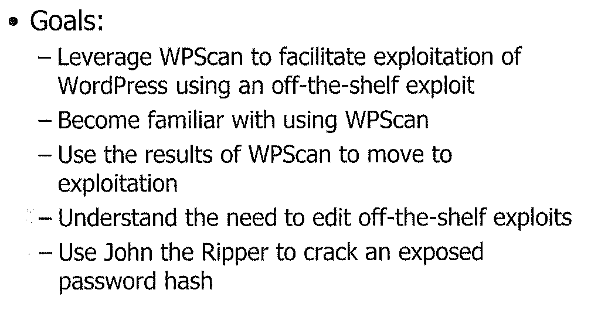
WPScan Demo
P68

Slide 37
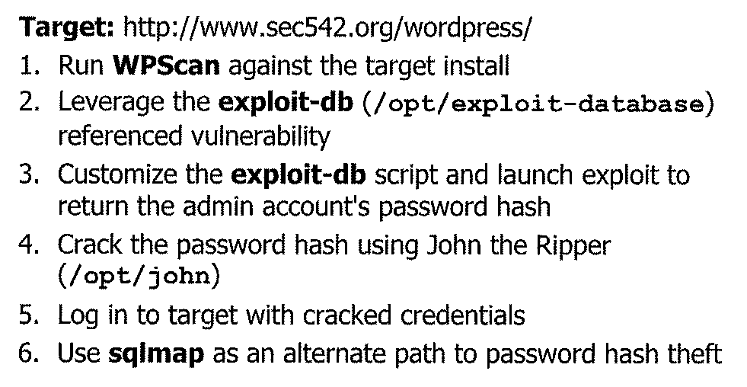

Slide 38

Web Application Attack and Audit Framework
“w3af is a Web Application Attack and Audit Framework. The project’s goal is to create a framework to help you secure your web applications by finding and exploiting all web application vulnerabilities.”
W3af is designed to perform the spidering part of mapping, all the server vulnerability discovery and exploitation

Slide 39
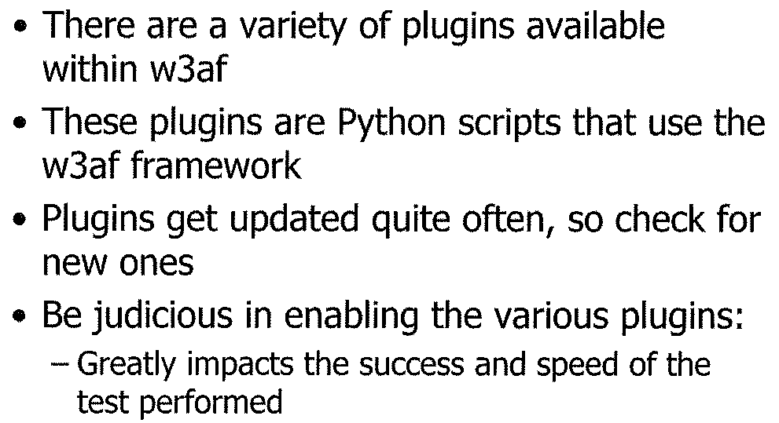
W3af Plugins

Slide 40
W3af Plugins
W3af Crawl plugins
W3af Evasion plugins
W3af Audit plugins
W3af demo

Slide 41

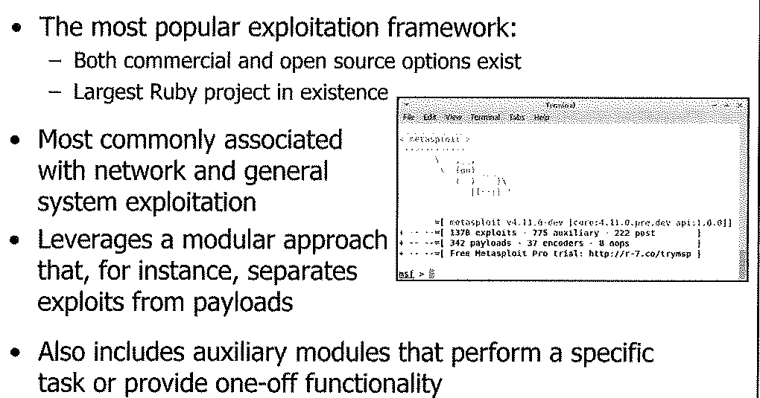

Slide 42
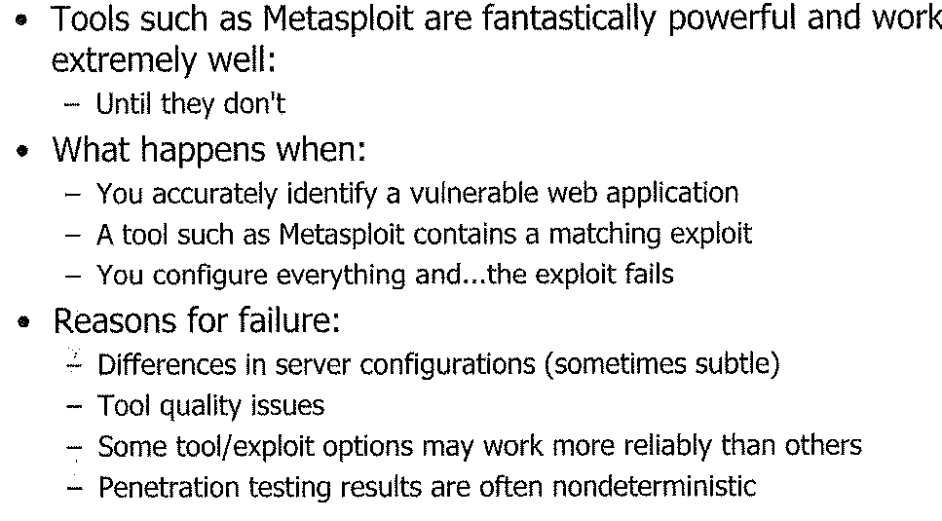
When tools fail
Research and Manual exploitation!!!

Slide 43
When tools fail
For example: you know the target has a vulnerable version (1.21.4) of MediaWiki installed
There is a know vulnerability CVE 2014-1610 and Metasploit has a matching exploit
However the Metasploit exploit failed, due to the use of default options
You should research the flaw, the exploit script and try manual exploit

Slide 44
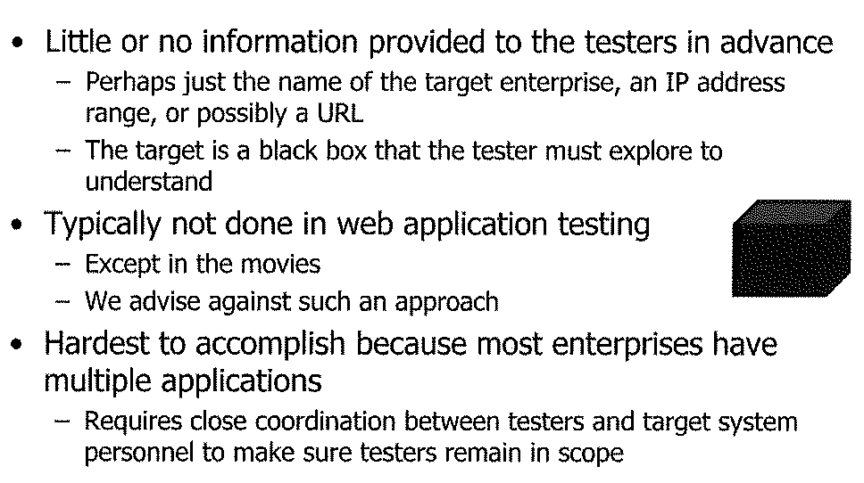
PEN Testing Methods – Black Box

Slide 45
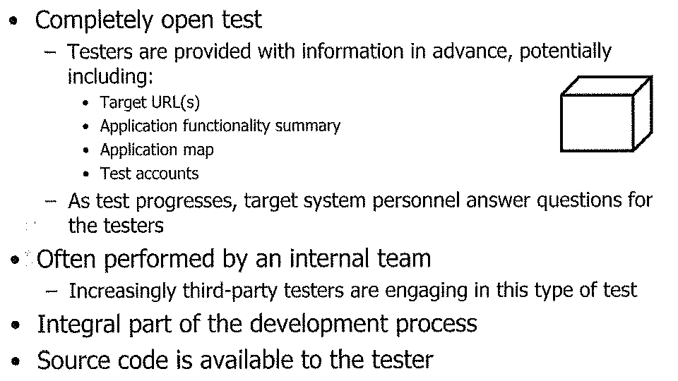
PEN Testing Methods – White Box

Slide 46
PEN Testing Methods – Grey Box
Testers are provided some limited information at the outset of a test
  URLs
  User accounts
As the test progresses, information gathering is critical for success
Most tests today fall into this category

Slide 47
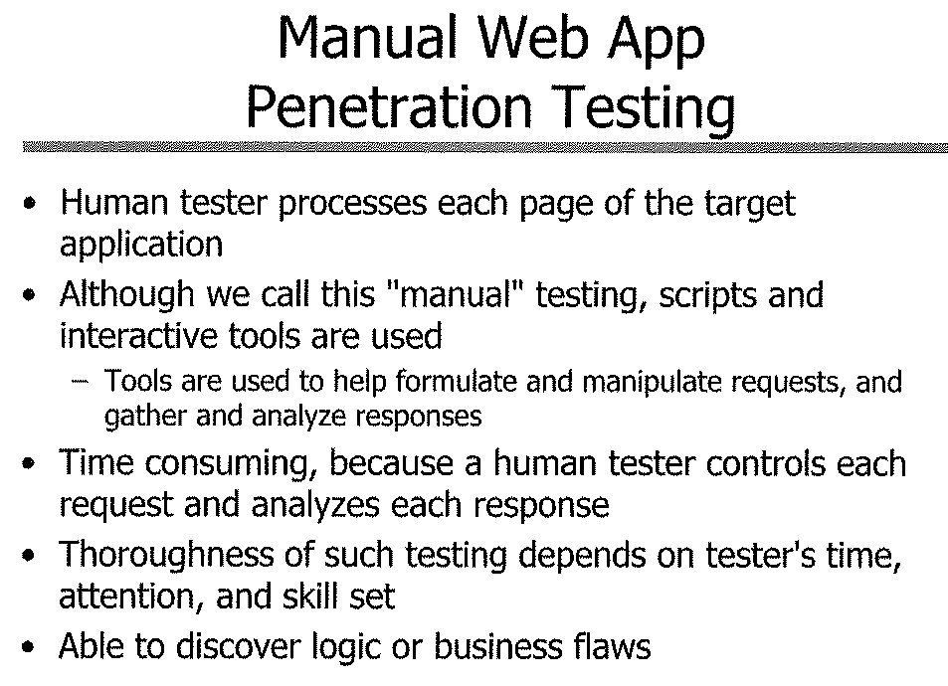

Slide 48
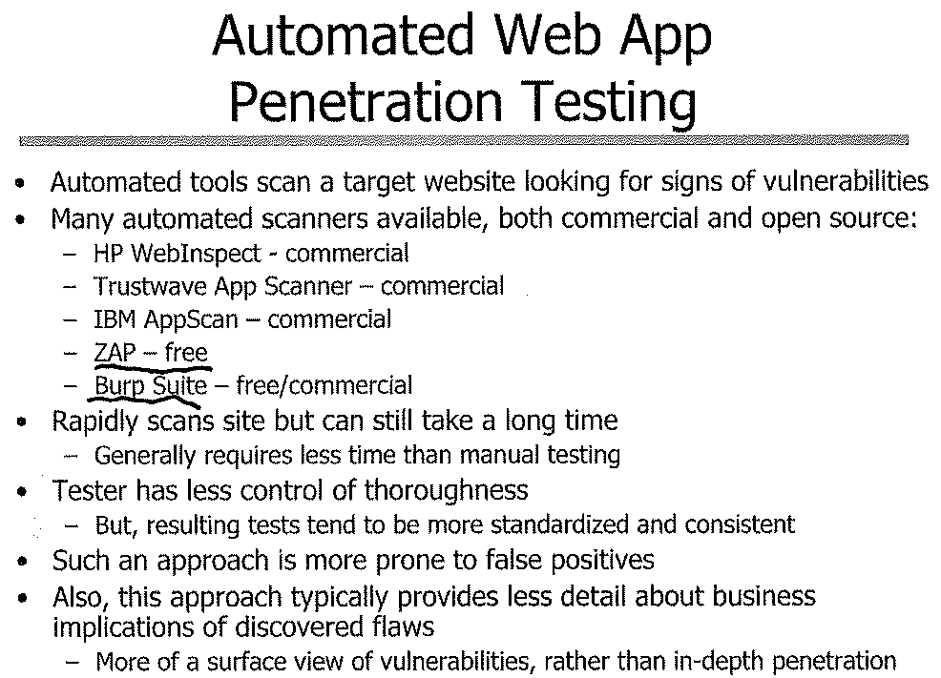

Slide 49
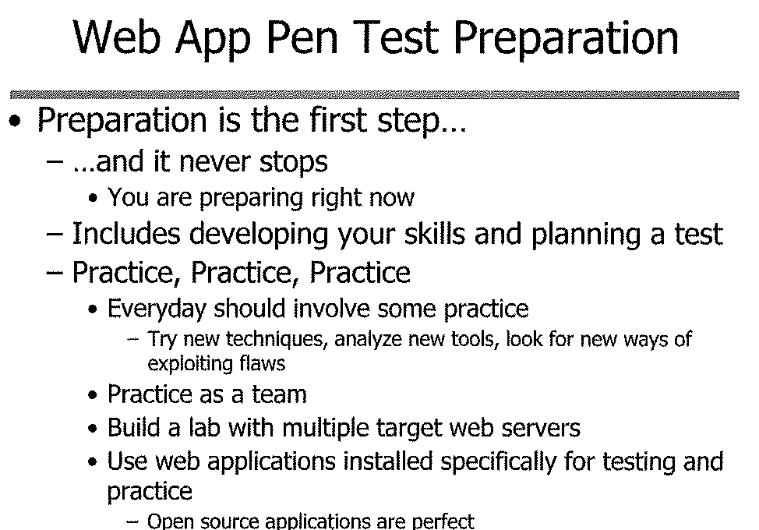

Slide 50
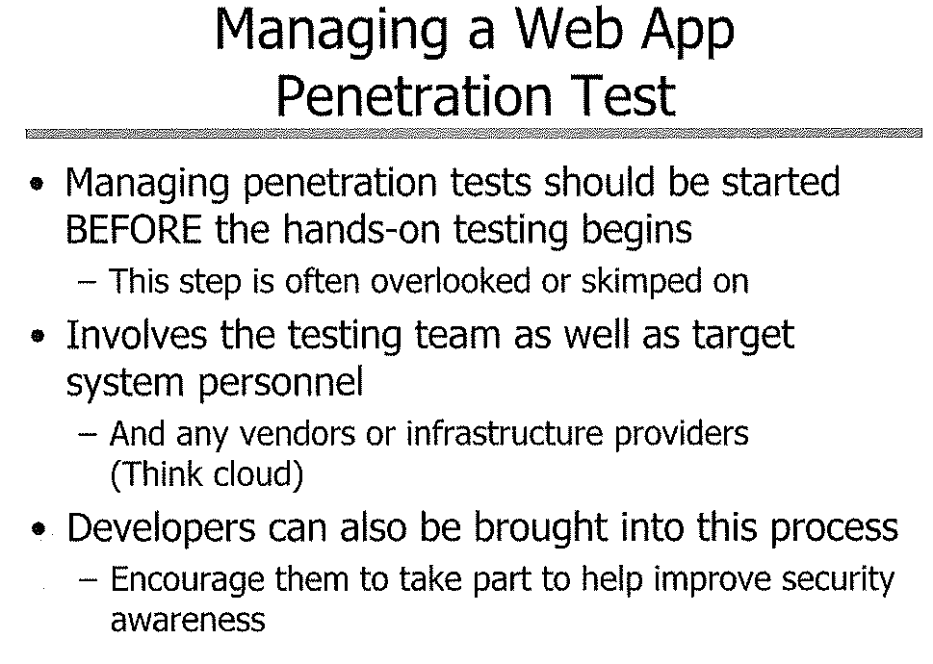

Slide 51
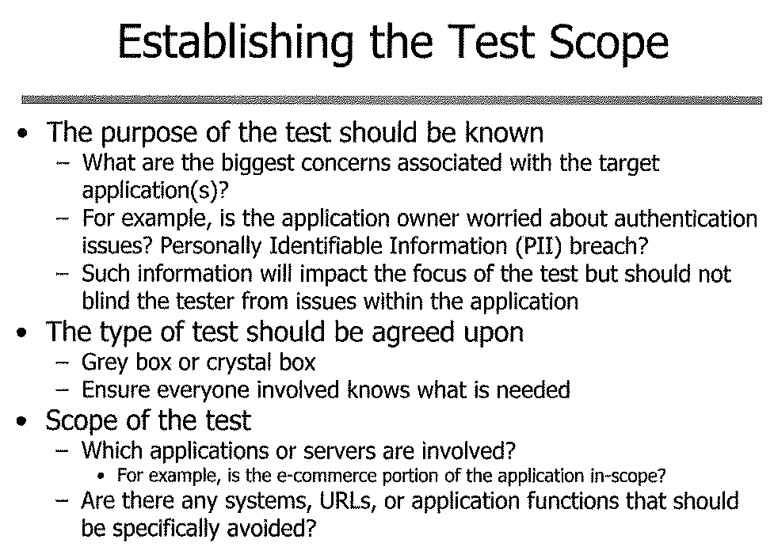

Slide 52
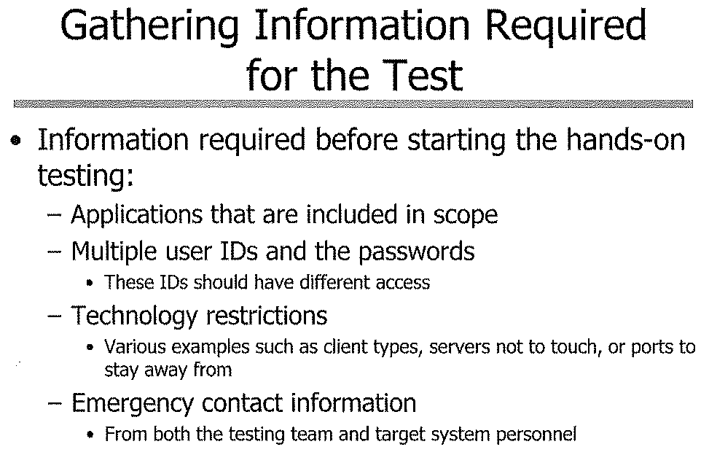

Slide 53
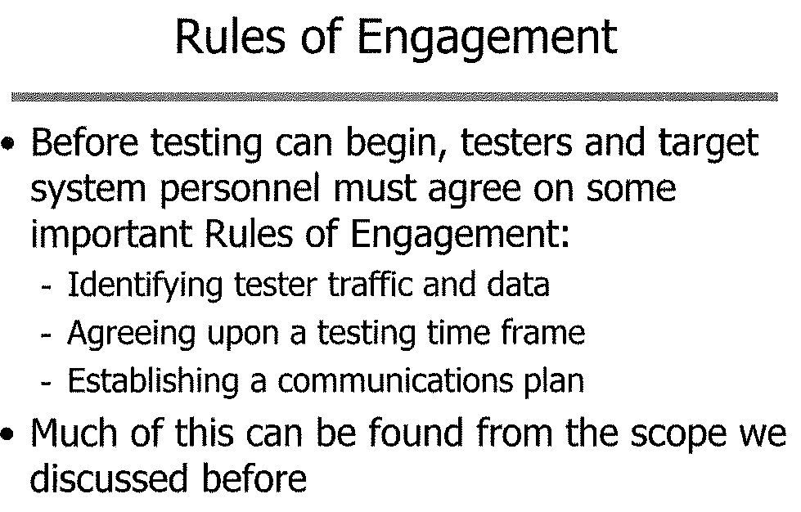

Slide 54
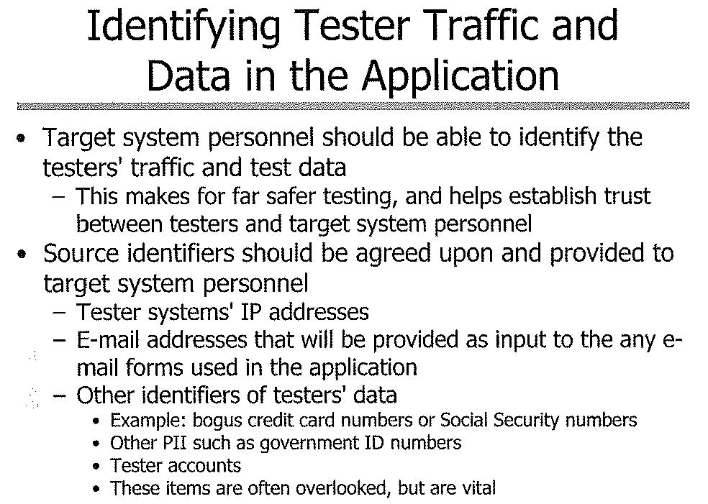

Slide 55
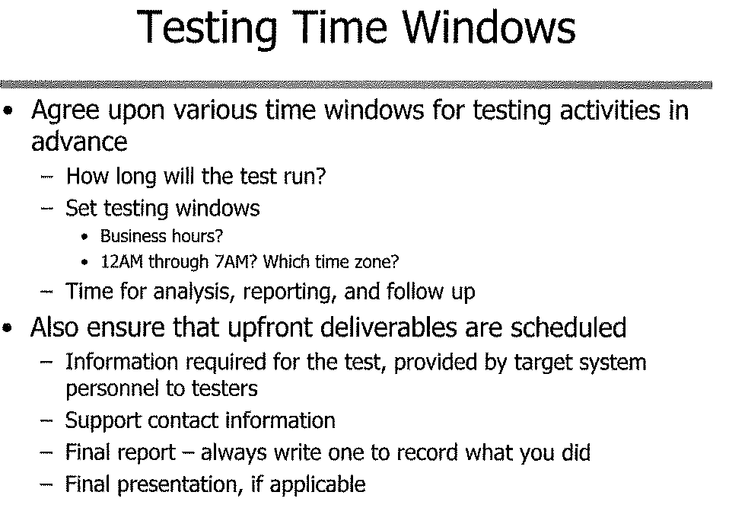

Slide 56
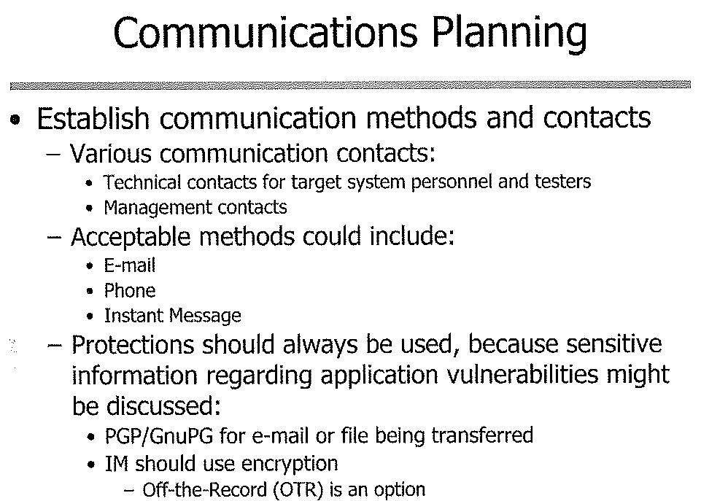

Slide 57
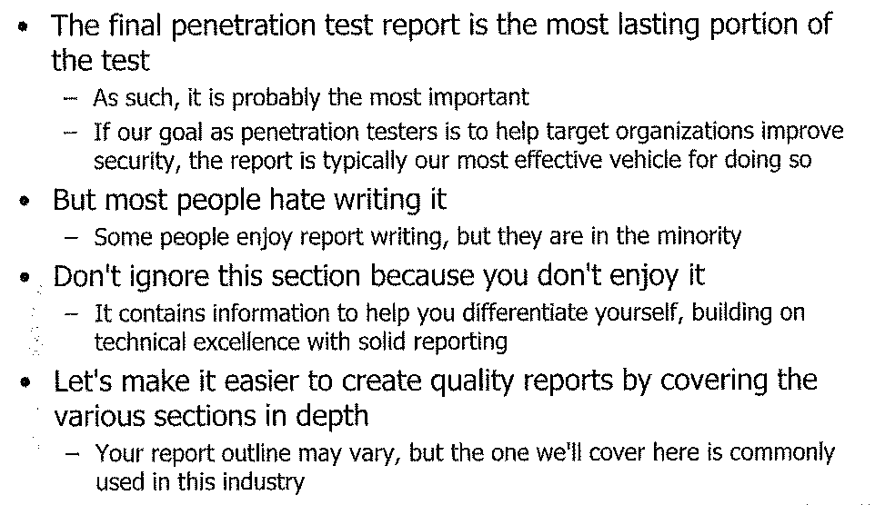
Reporting

Slide 58
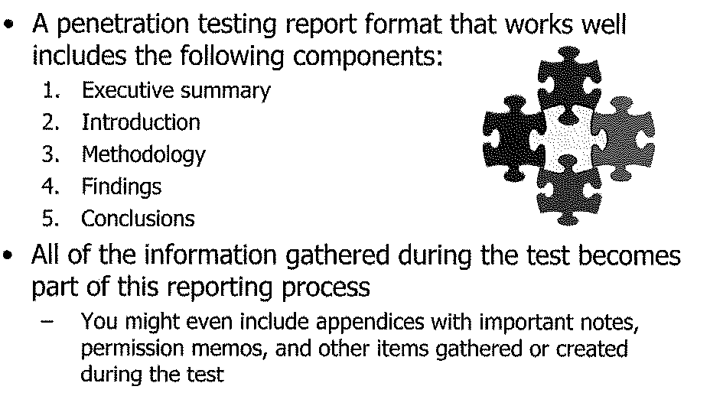
Reporting Pieces

Slide 59
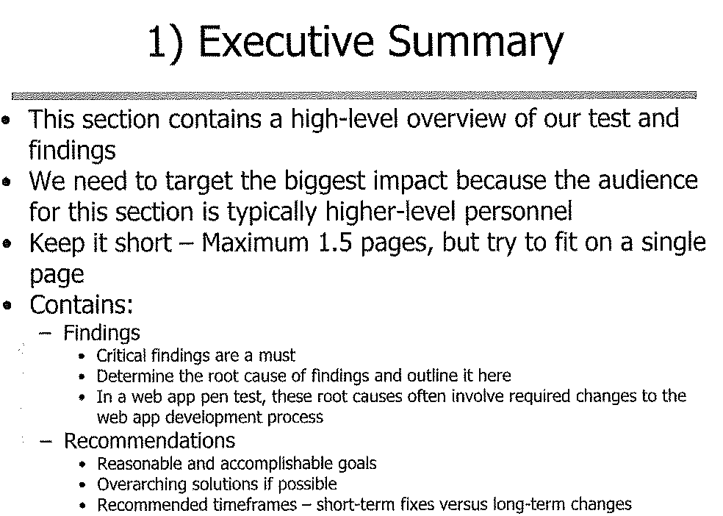

Slide 60
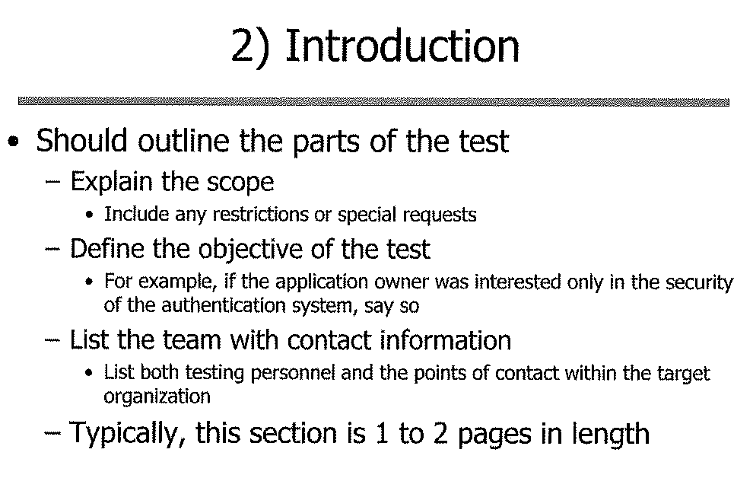

Slide 61
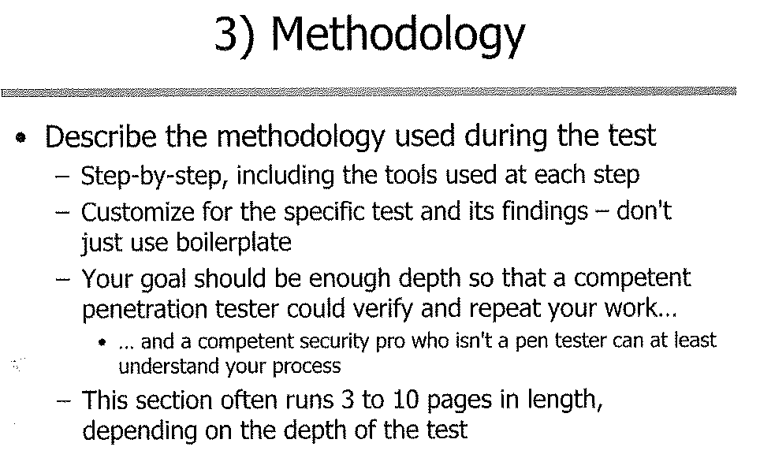

Slide 62
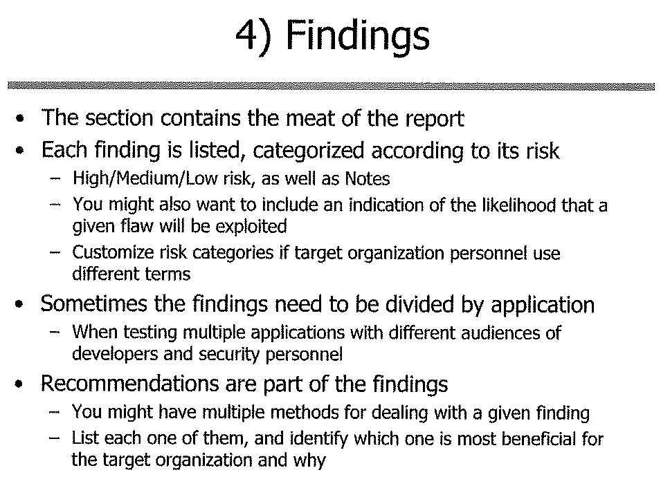

Slide 63
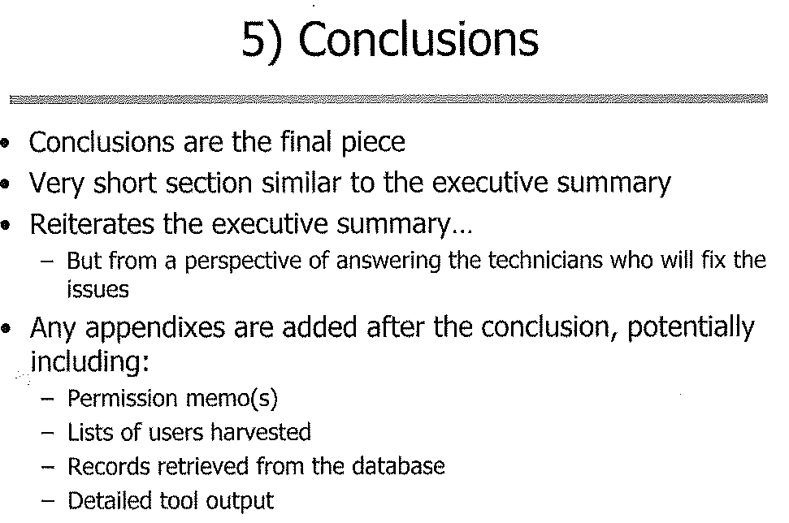

Slide 64
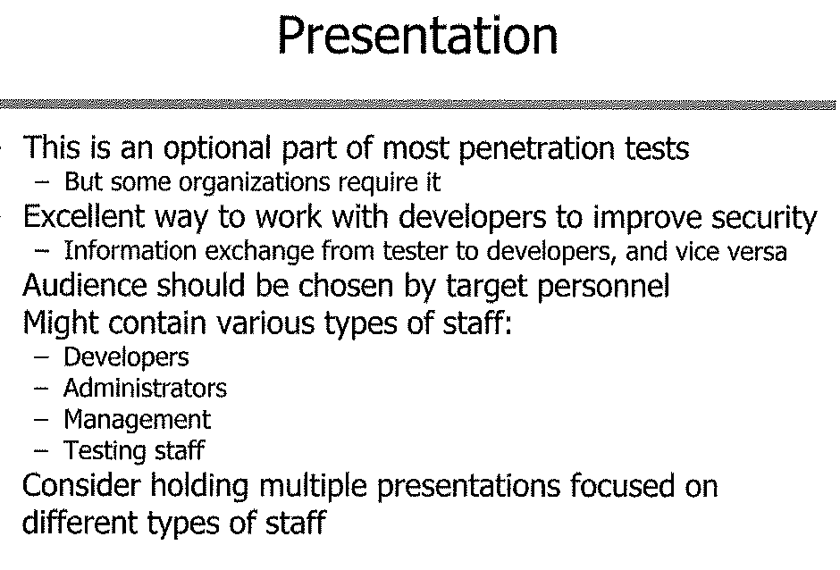

Slide 65
Bonus Assignment
Perform PEN testing on the following website:
https://www.math-cs.ucmo.edu/~catsdev/

